Slide 1
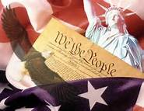
U.S. History E.O.C.T.
Part II
New Republic to Reconstruction

Slide 2
Domain II
Standards 6 - 10
Impact of territorial expansion and growth of
the U.S.
North & South division before the Civil War
Key Events and issues relating to the Civil War
Key elements of Reconstruction

Slide 3
Territorial Expansion
Standard 6
Northwest Ordinance
The first US governmental territory outside the original states was the Northwest Territory.
This law demonstrated to Americans that their government intended to encourage westward expansion.
The ordinance banned slavery in the NW Territory.
The law also mandated the establishment of public schools in the NW Territory.

Slide 4
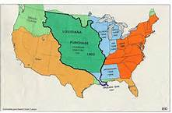
Louisiana Purchase
Jefferson sent representative to France to purchase the port city of
New Orleans.
Purchased the territory from France for $15 million
Napoleon offered to sell the entire Louisiana Territory to the U.S.
  Doubled the size of U.S. territory

Slide 5
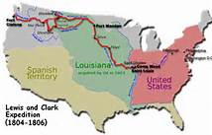
Louis & Clark Expedition
Jefferson sent Lewis & Clark to explore Louisiana and western
lands all the way to the Pacific Ocean.
On their 16 month expedition, they charted the trails west,
mapped rivers and mountain ranges, wrote descriptions and
collected samples of unfamiliar animals and plants.
They recorded facts and figures about Native American tribes
and customs west of the Mississippi.

Slide 6
Causes of War of 1812
President Madison declares war on Great Britain
Reasons:
  Impressment of U.S. sailors in British navy
  Americans objected to restrictions Britain was enforcing to prevent neutral American merchants from trading with the French.
  Americans suspected British of giving military support to Native Americans
  Americans wanted to drive the British out of North America
War helped form a strong national identity

Slide 7
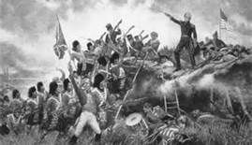
Results of War of 1812
Major result was the end of all US military hostility with
Great Britain.
Never again would Britain and the US wage war over
diplomacy, trade, territory, or any other dispute.
The war also solidified America’s army and navy as worthy
opponents of any European military force.

Slide 8

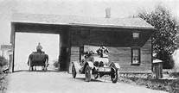
National Infrastructure
Private companies built the young nation’s roads and waterways.
These roads were often turnpikes, or tolls roads, which travelers
paid a fee to use.
Where roads could not be built barges were used on rivers to
carry people and goods.
Where roads and rivers did not run, canals (artificial rivers)
were built.

Slide 9
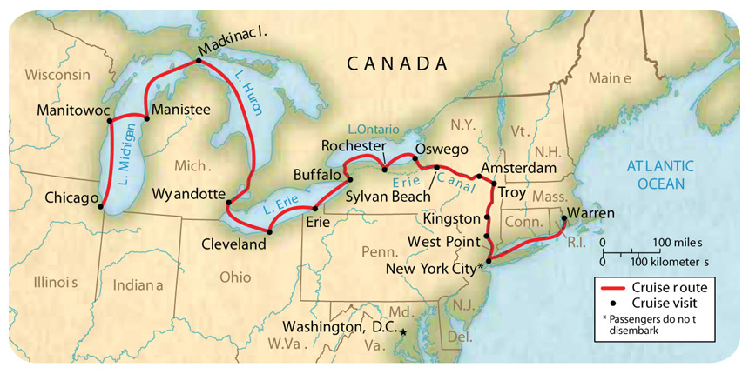
Erie Canal
Connected the Great Lakes to the Atlantic Ocean.
Took 8 yrs. to build by mostly immigrant laborers.
Stretches 353 miles from Lake Erie to the Hudson River,
which flows into the Atlantic.
Opened up western NY and regions further west to increased
settlement
Helped to unite new regions with the Atlantic states.

Slide 10
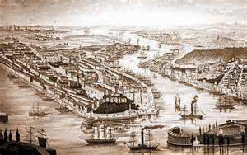
Rise of New York City
Until 1790, NYC was the capital of the US.
Civic development turned this colonial town into a great economic
center established on a grid of city blocks.
Largest US city at the time.
Trade grew when the Erie Canal opened.
City was home to the biggest gathering of artisans and craft workers
in the US.
Banking and commercial activities would soon make it the leading city
in all of North America.

Slide 11
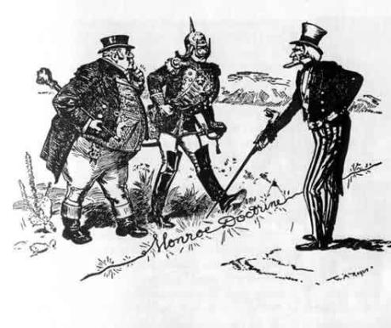
Monroe
Doctrine
Established U.S. dominance in the western hemisphere
European countries could not claim any more colonies here
President Monroe warned European nations not to meddle in
the politics of North & South America.
The U.S. would stay out of European affairs.
The US would remain neutral in wars in Europe, but if battles
took place in the New World, the actions would be viewed as
hostile.

Slide 12
Sample Question
What was the importance of the Monroe Doctrine in 1823?
It reinforced tensions between pro-slavery and anti-slavery factions in the United States.
It authorized the creation of a permanent professional military to defend the United States.
It established the U.S. policy of preventing other nations from interfering in Latin America.
It proclaimed the U.S. intention of expanding it political borders westward to the Pacific Ocean.

Slide 13
Answer
C. It established the U.S. policy of preventing other nations from interfering in Latin America.

Slide 14
Sample Question
Use this quote to answer the question:
“British cruisers have been in the continued practice of violating the American flag on the great highway of nations, and of seizing and carrying off person sailing under it…”
-President James Madison,
in a message to Congress
What resulted from the actions described by President Madison in the quotation?
The beginning of the War of 1812
The outbreak of the Revolutionary War
The signing of the Treaty of Paris of 1783
The adoption of the Articles of Confederation

Slide 15
Answer
A. The beginning of the War of 1812

Slide 16
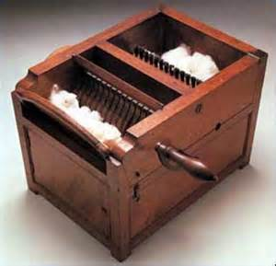
Industrial Revolution
Standard 7
Industrial revolution is the name given to the period in the 19th century
when power driven machines replaced workers using hand tools.
Eli Whitney, Inventor
  Interchangeable parts: aided growth of industry in the North
  Cotton gin: aided growth of cotton as the main cash crop of the South
  Cotton gin processed more cotton in a day than a person working by hand.
  Greatly raised cotton profits.
  Unskilled slaves were often put to work running the cotton gin in southern states.

Slide 17
Manifest Destiny
Between 1800 & 1860 the US more than doubled in size and states increased from 16 to 33.
Motivation for America’s westward growth
  The desire for Americans to own their own land.
  Discovery of gold and other valuable resources
  The Belief that the US was destined to stretch across North America, “from sea to shining sea.”
Territory's gained
  1845: Texas annexation
  1846: Oregon Country (divided with Britain)
  1848: Mexican Cession (resulted from Mexican War)

Slide 18
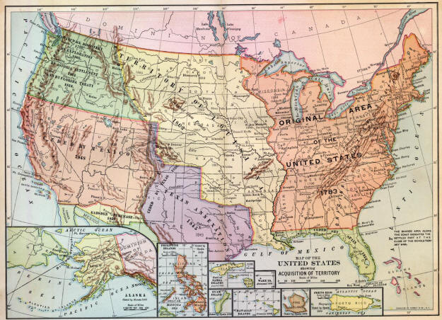

Slide 19
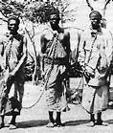
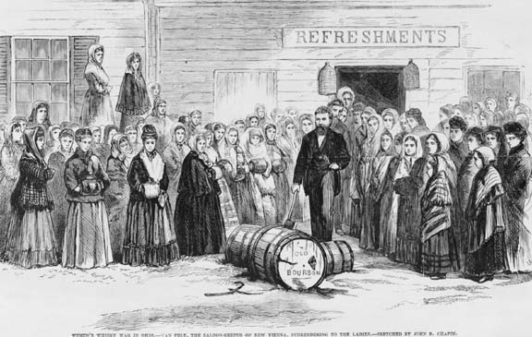
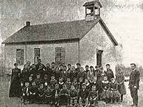
Reform Movements
Temperance: campaign to reduce, or “temper” the use of alcohol
Abolition: campaign to abolish (end) slavery
Education: effort to support the funding of public education

Slide 20
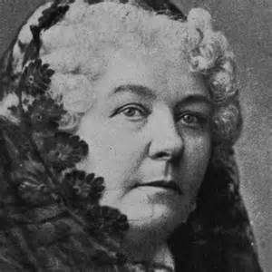
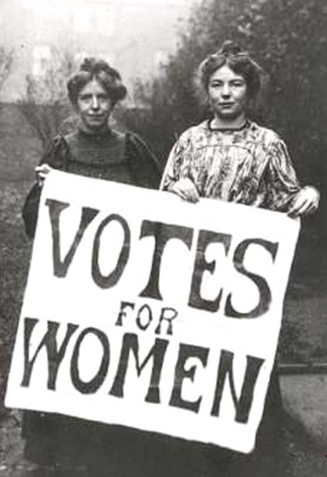
Women’s Suffrage
Women’s Rights convention held in Seneca Falls, NY.
Elizabeth Cady Stanton, leading advocate for the full rights of
citizenship, including voting rights, parental and custodial rights.
Main issue: Women’s Suffrage
Seneca Falls Convention is the event that marked the
beginning of organized efforts by women in the US to
gain civil rights equal to those of men.

Slide 21
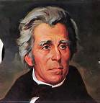
Jacksonian Democracy
Sought a stronger presidency and executive branch, and
a weaker congress.
Broadened public participation in government.
Expanding voting rights
  Non-property owners could vote by 1828
  Now all adult white males could vote
  Most supported Andrew Jackson, the symbol of the “common man”
  Popular votes counted for the first time in 1828
  Increased suffrage led to increased nationalism

Slide 22
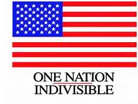
American Nationalism
Americans believed their nation was different from,
and superior to, other nations.
Most Americans of the time shared the Protestant
religion and English language, ancestry, and culture.
Altogether, these beliefs comprise American nationalism.

Slide 23
Sample Question
Which term BEST describes the period during which white male suffrage greatly expanded in the United States?
Manifest Destiny
The Enlightenment
The Great Awakening
Jacksonian Democracy

Slide 24
Answer:
A. Manifest Destiny

Slide 25
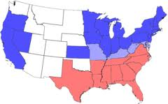
North-South Divisions Related to Westward Expansion
Standard 8

Slide 26
Abolitionist Movement
Key abolitionists
  William Lloyd Garrison – writer, and editor, founded regional and national abolitionist societies. Published and anti-slavery newspaper that printed graphic mistreatment of slaves.
  Frederick Douglass – a former slave, traveled widely giving speeches on behalf of African Americans, women, and native Americans. Later, published his own anti-slavery newspaper.
  Grimke sisters – southern women who lectured publicly about the evils of slavery they had seen growing up on a plantation.

Slide 27
Slavery as a Major Political Issue
Most white southerners opposed abolition.
White writers and public speakers argued that slavery was a necessary
part of life in the South.
Proslavery arguments claimed that slaves were treated better than
factory workers in the North.
When settlers in the slaveholding Missouri Territory sought statehood, proslavery and antislavery politicians made slavery a central issue in national politics.

Slide 28
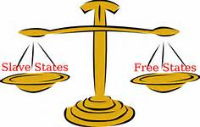
Missouri Compromise
1819 - Missouri requested admission into the Union
as a slave state
There were an even number of slave and free states
Much congressional debate
  1820 - Compromise
      Maine would be admitted as a free state
      Missouri would be admitted as a slave state
      North of 36, 30 North latitude: slavery prohibited
      South of 36, 30 North latitude: slavery allowed

Slide 29
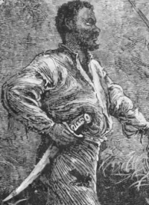
Nat turner
African American preacher who believed his
mission on Earth was to free his people from slavery.
Led a slave rebellion on four Virginia plantations.
Appx. 60 whites were killed, and Turner was captured, tried, executed.
To stop the uprisings, white leaders passed new laws to limit the activities of slaves and to strengthen the institution of slavery.

Slide 30
Nullification Crisis
Attempt by South Carolina to nullify of
federal tariff in 1832.
  South Carolina protested/refused to pay
  Vice-President John C. Calhoun led the protest
  Threatened to secede if force was used
  President Jackson ->Force Act
  Henry Clay offered a compromise tariff
    Tariff would gradually be lowered over a ten year period
Increased the issue of sectionalism: putting the
interests of a region over those of the entire nation

Slide 31
Mexican-American War
1846 - U.S. declares war on Mexico over boundary dispute.
Congressman David Wilmot proposes that slavery be
prohibited in any territory acquired in the war.
Much congressional debate over the Wilmot Proviso;
it is defeated
1848 - U.S. wins, the region was ceded to the US as part
of the Treaty of Guadalupe Hidalgo.
Treaty of Guadalupe Hidalgo establishes boundary at
Rio Grande; gives entire southwestern territory to U.S.
(Mexican Cession)

Slide 32
Sample Question
The western expansion of the United States in the early 1800s provoked a congressional debate over the slavery issue. Congress resolved this debate by
Making the Louisiana Purchase
Passing a constitutional amendment
Adopting the Missouri Compromise
Accepting the doctrine of nullification

Slide 33
Answer
C. Passing a constitutional amendment

Slide 34
Sample Question
Which principle of U.S. government did the Nullification Crisis of 1832 directly challenge?
Federalism
Judicial review
Popular sovereignty
Checks and balances

Slide 35
Answer
Federalism
When South Carolina declared their nullification of the federal tariff, they were challenged federal law. No state laws, policy, or court decision can conflict with federal law. Therefore, South Carolina was challenging the principle of federalism.

Slide 36
Compromise of 1850
1848 - Gold discovered in California
1849 - Thousands of people travel to California in the Gold Rush
California’s population escalates enough to apply for statehood
(free state)
1850 - Much congressional debate (even number of free states and slave states)
Compromise of 1850:
    California will be a free state
    Utah and New Mexico will decide slavery by popular sovereignty
    New Mexico would carve its borders from the Texas.
    Slave trade is abolished in Washington, D.C.
    A stronger Fugitive Slave Law is passed to satisfy a pro-slavery South

Slide 37
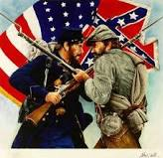
Causes, Main Events, & Consequences of the American Civil War Standard 9

Slide 38
Kansas-Nebraska Act
Repealed the Missouri Compromise by reopening territory that had
been closed to slavery
Left the slavery issue to be decided by the people who settled in those
territories (popular sovereignty)

Slide 39
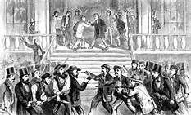
“Bleeding Kansas”
A race to Kansas between those who supported slavery
and those who didn’t began
Anti-slavery and pro-slavery forces fought against each other
Violence between the two sides created warlike conditions.
Two territorial legislatures will be chosen
Popular sovereignty will fail

Slide 40
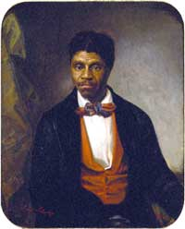
Dred Scott Case
Dred Scott was a slave that had been taken into free
territory
After his owner died, Scott wanted his freedom
The Supreme Court decision:
  ruled that African Americans were not citizens of the U.S.
  African Americans were not free just because they were taken into free territories by their owners
  Laws like the Missouri Compromise were unconstitutional
  Congress could not deny slave owners from taking slaves into the western territories because they were property under the 5th Amendment

Slide 41
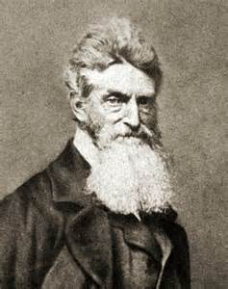
John Brown
A staunch abolitionist
Had committed five murders of pro-slavery people in Pottawatomie,
Kansas in 1856
In 1859, he raided a federal arsenal in Harper’s Ferry, VA, in an
attempt to arm a slave resurrection
He was captured, charged with treason, and executed by hanging for
his crimes

Slide 42
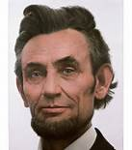
Preserving the Union
President Lincoln believed that preservation of the U.S (the Union) was a
top priority
He did not believe the southern states had the right to secede from the Union.
He never considered the Confederacy a separate country.
Lincoln often stated that he only wished to restrict the spread of slavery, not
to abolish it, over time he did embrace the idea of ending slavery in the U.S.

Slide 43
North vs South
Southern forces opened fire on Union forces at Fort Sumter, war had begun.
The war lasted 4 years and the lives of 821,000 soldiers.
South was at a serious disadvantage being primarily and agricultural based society.
The numerical and industrial superiority of the northern economy proved too much for the South to overcome.
The South did have far more superior military leaders than the North

Slide 44
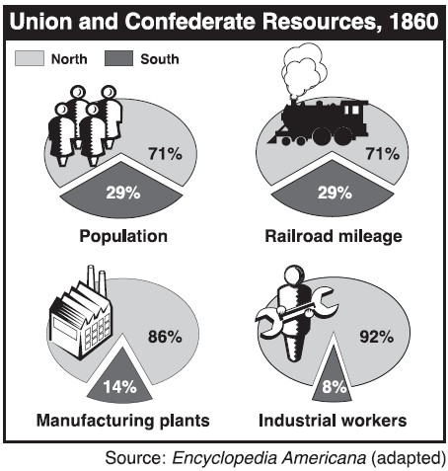
Economic Disparity between the North and the South

Slide 45
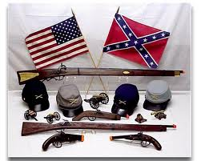
Civil War Leaders
North/Union
  President: Abraham Lincoln
  Generals:
    Ulysses S. Grant – defeated Lee and ended the war
    William T. Sherman – capture the railroad city of Atlanta, GA and led a destructive march through Georgia
South/Confederacy
  President: Jefferson Davis
  Generals:
    Robert E. Lee – commander the Army of Northern Virginia; successfully won defensive battles against the Union, but lost both attempts at offensive battles
    “Stonewall” Jackson – Lee’s right-hand man; helped him win many victories against the Union

Slide 46
Civil War Battles
Fort Sumter (April, 1861) – where the Civil War began
Antietam (August, 1862) – Lee’s first attempt to fight an offensive battle and first one outside the Confederacy; he lost
Gettysburg (July 1-3, 1863) – Lee’s second attempt to fight an offensive battle; the turning point of the war; Lee would never recover from this loss
Vicksburg – “the nail that held the two halves of the Confederacy together” (Davis); located on the Mississippi River, it fail to Union control on July 4, 1863; the Union had control of the Mississippi
Atlanta (September, 1864) – the main rail center of the southeast captured by General Sherman and where he began his March to the Sea

Slide 47
Habeas corpus
Not all Northerners supported Lincoln’s efforts to preserve the Union.
In some states Lincoln suspended the constitutional right of Habeas Corpus (the legal rule that anyone imprisoned must be taken before a judge to determine if the prisoner is being held in legal custody).
Lincoln used his emergency posers to legalize the holding of Confederate sympathizers without a trail and judge to agree they were legally imprisoned.

Slide 48
Emancipation Proclamation
After the Battle of Antietam, President Lincoln announced he
would issue his proclamation on January 1, 1863 if the Confederacy
did not surrender
January 1, 1863, Lincoln announced the he was freeing the
slaves who were still in the states that continue to fight the Union
The Union army had a new purpose for fighting the war:
they would free all slaves as they moved through the states at
war with them
Slaves in states still in the Union were not freed by the
Emancipation Proclamation, but will be freed by the 13th
Amendment

Slide 49
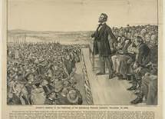
Gettysburg address
A dedication of a military cemetery at the Gettysburg battlefield
4 months after 51,00 people were killed there.
Lincoln rose to speak, starting with his famous words,
“four score and seven years ago…” , considered one of the most
famous speeches in history.
The speech helped to raise the spirits of Northerners who had
grown weary of the war.
He convinced the people that the US was one indivisible nation.

Slide 50
Lincoln’s second inaugural address
When Lincoln delivered his second inaugural address, Union victory over
the Confederacy was certain.
Americans foresaw and end to slavery.
He expressed sorrow at that the states had not been able to resolve their
differences peacefully.
He urged Americans not to seek revenge on slaveholders and their
supporters and the military.
He urged reconstruction of the South,
“with malice toward none; with charity or all.”

Slide 51
Sample Question
Which factor provided a military advantage during the U.S. Civil War?
Over 80% of the nation’s factories existed in the North
Southern merchant ships outnumbered those controlled by the North
Seventy percent of U.S. railroad tracks existed in the southern territory.
The North made an alliance with France to receive troops and other aid to fight the South.

Slide 52
Answer
A. Over 80% of the nation’s factories existed in the North
European nations essentially remained neutral throughout the course of the U.S. Civil War. The North possessed more merchant ships than the South, as well as the majority of railroad tracks. The North was far more industrialized than the South. Northern factories gave the Union a powerful military advantage.

Slide 53
Reconstruction
1865-1877
Standard 10
US focused on abolishing slavery
Destroying the Confederacy
Passing new Constitutional Amendments
Readmit Southern States

Slide 54
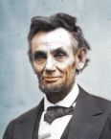
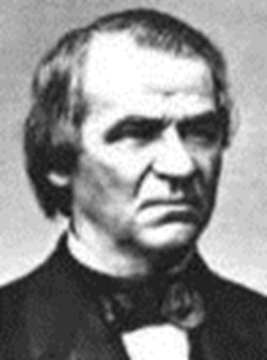
Presidential Reconstruction
Abraham Lincoln began Reconstruction in
1865.
Carried out by Andrew Johnson after the assassination of Pres. Lincoln.
The purpose of Presidential Reconstruction
was to readmit the southern states to the
Union as quickly as possible.

Slide 55
Radical Republicans
Republicans in Congress, however, were outraged by the fact that the new southern state governments were passing laws that deprived the newly freed slaves of their rights.
To remedy the Radical Republicans’ outrage, Congress forced the southern states to reapply for admission to the Union and to take steps to secure the rights of the newly freed slaves.

Slide 56
Radical Republicans
The key feature of the effort to protect the rights of
the newly freed slaves was the passage of 3 Constitutional
Amendments during and after the Civil War.
Southern states were required to ratify all these
amendments before they could rejoin the Union.

Slide 57
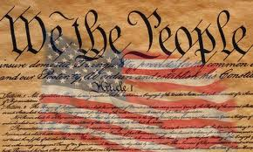
The 13th, 14th, and 15th Amendments
13th Amendment: abolished slavery and involuntary servitude in the United States.
14th Amendment: defined U.S. citizenship as including all persons born in the U.S., including African Americans; guaranteed that no citizen could be deprived of his/her rights without due process.
15th Amendment: removed restrictions on voting based on race, color, or ever having been a slave; granted the right to vote to all male U.S. citizens over the age of 21.

Slide 58
Other Great Accomplishments
During the Reconstruction period, African Americans made progress in many areas.
African Americans started newspapers, served in public office, and attended new colleges and universities established for them.

Slide 59
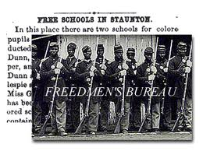
One of these institutions, Morehouse College, was founded in Atlanta in 1867 as the Augusta Institute.
Congress also created the Freedmen’s Bureau to help African Americans to make the transition to freedom. The Freedmen’s Bureau helped former slaves solve everyday problems by providing food, clothing, jobs, medicine, and medical-care facilities.

Slide 60
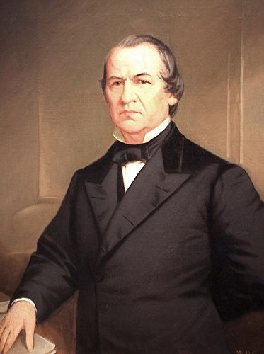
Impeachment of President
Andrew Johnson
The U.S. Constitution allows Congress to remove the president from office by impeaching (accusing) him of committing “high crimes and misdemeanors.”
Radical Republicans impeached Johnson when he ignored laws they had passed to limit presidential powers.
John missed being convicted by one vote.

Slide 61
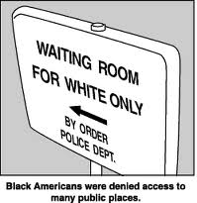
Resistance to Racial equality
Not all white southerners accepted the equal status of former slaves. After the 13th Amendment abolished slavery, all former slave states enacted Black Codes, which were laws written to control the lives of freed slaves in ways slaveholders had formerly controlled the lives of their slaves.
Black Codes deprived voting rights to freed slaves and allowed plantation owners to take advantage of black workers in ways that made it seem slavery had not been abolished.

Slide 62
Other white southerners formed secret societies that used murder, arson, and other threatening actions as a means of controlling freed African Americans and pressuring them not to vote. The Ku Klux Klan was the worst of these societies.
The Klan, or KKK, was founded by veterans of the Confederate Army to fight against Reconstruction.
Some southern leaders urged the Klan to step down because Federal troops would stay in the South as long as African Americans needed protection from it.

Slide 63
Election of 1876
After the controversial election of 1876, Democrats gave the White House the Rutherford B. Hayes in exchange for Washington loosing its grip on the Southern States.
Reconstruction came to an end with the Compromise of 1877, which withdrew Union troops from the South.
With the end of Reconstruction and the rise of groups like the KKK, African –Americans soon lost the political position they gained.

Slide 64

Sample Question
Use this list of events during the 1800s to answer the question.
• the full pardon of former Confederate citizens
• resistance to the passage of the 14th Amendment
• the removal of a Cabinet member without the approval of Congress
The actions described in the list directly resulted in:
the assassination of President Abraham Lincoln
the impeachment of President Andrew Johnson
the landslide election of President James Buchanan
the congressional opposition to President Ulysses Grant

Slide 65
answer
B - the impeachment of President Andrew Johnson

Slide 66
The end

